Slide 1







TEAM OF
Chandrakant Pradhan
FROM NEW DELHI
Mani Vijaya Raman T
Kavya Choudhary
Vignesh Ram A
Priyanka K
Thariq Mohammed Z
Upasana Nandi

Slide 2

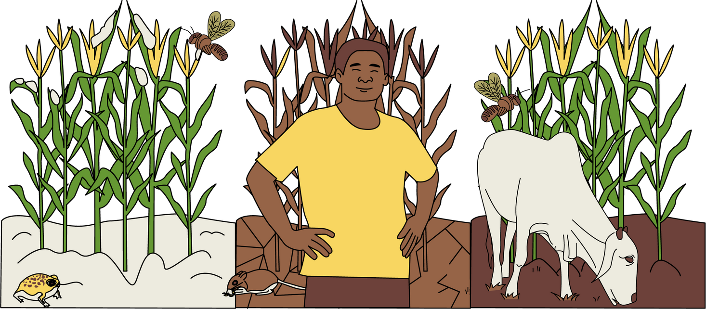
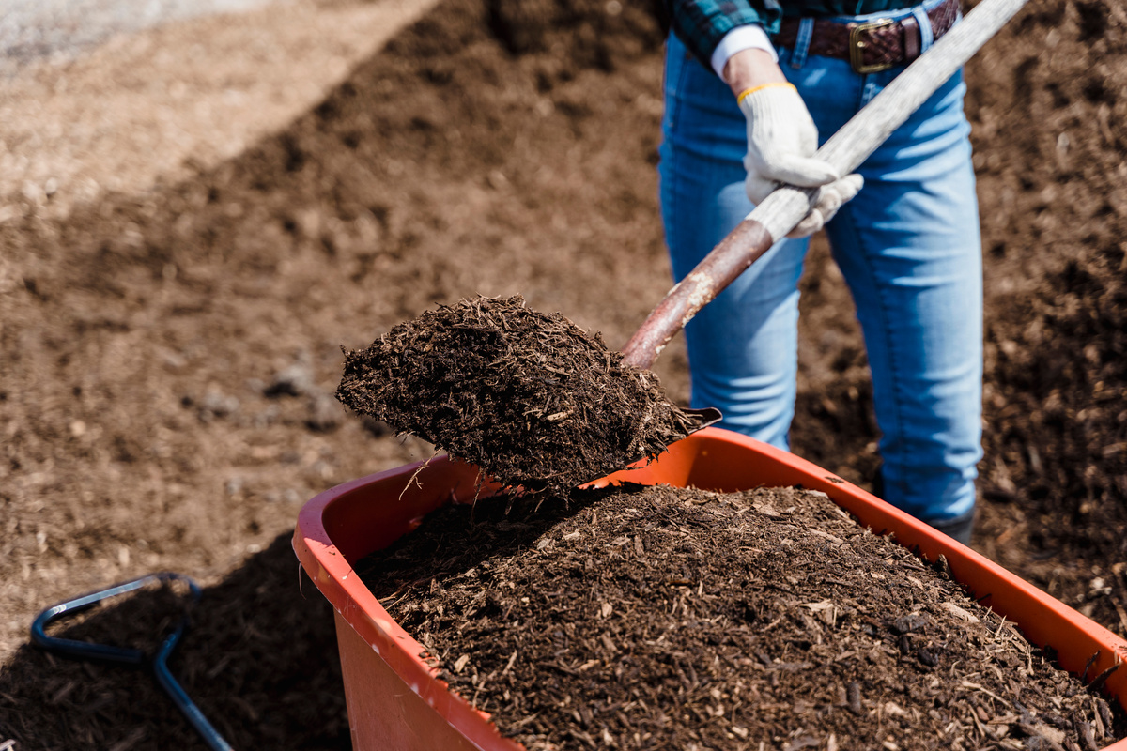
ABOUT THE CASE..
States mentioned -
Punjab
Haryana
Parameters used to measure sustainable practices -
Weed Infestation
Water Consumption
Fertilizer Consumption
For years,
2019 and 2020
CRM Practices adopted
Burning
Sustainable
Both
Methods in Practice:
Soil Incorporation
Mulching
Collection
Complete Burning
Partial Burning

Slide 3
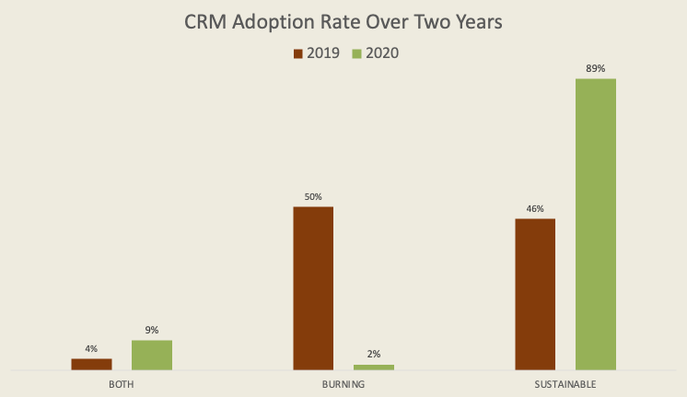

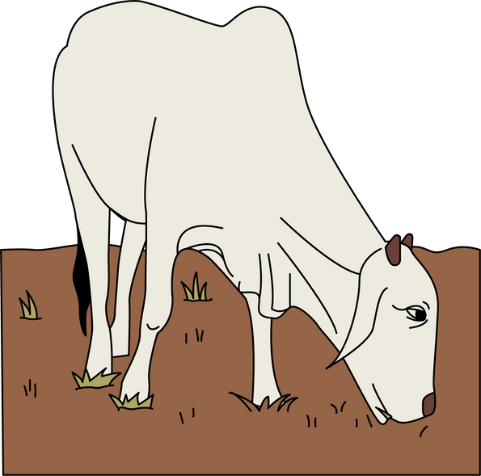
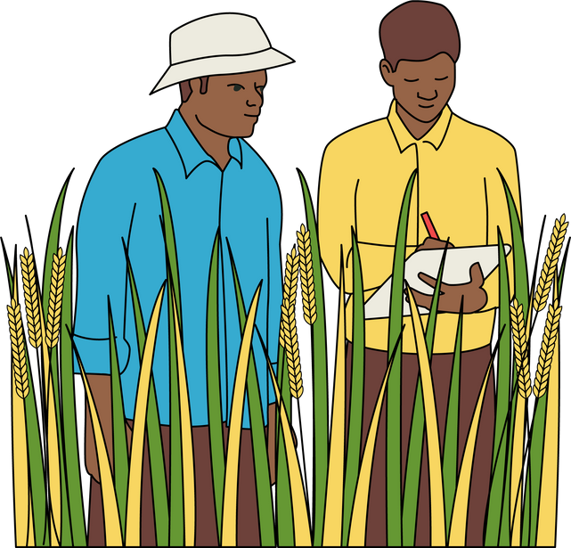
ADAPTION SCENARIO
Facts:
The Burning Method is predominantly adopted over the year 2019
The Sustainable Method is boosted for adoption over the year 2020
The suitable combination of sustainability is inferred as following

Slide 4
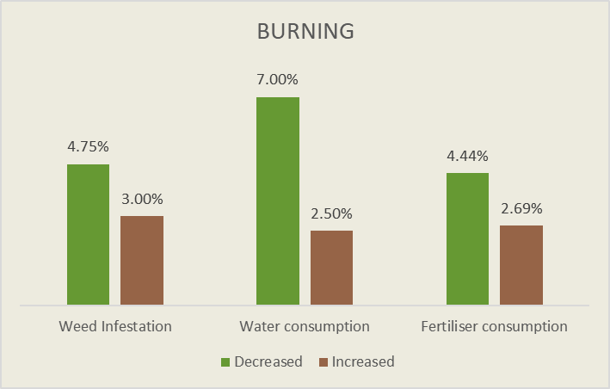
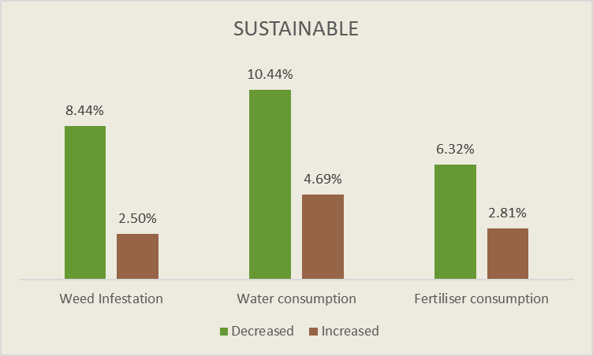
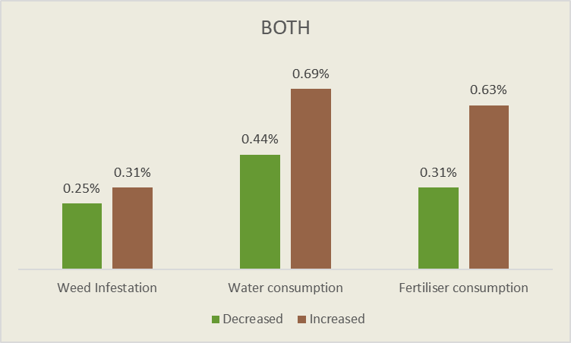

Effects of CRM Practice (2019)
BOTH
BURNING
SUSTAINABLE
Decreased
Increased

Slide 5

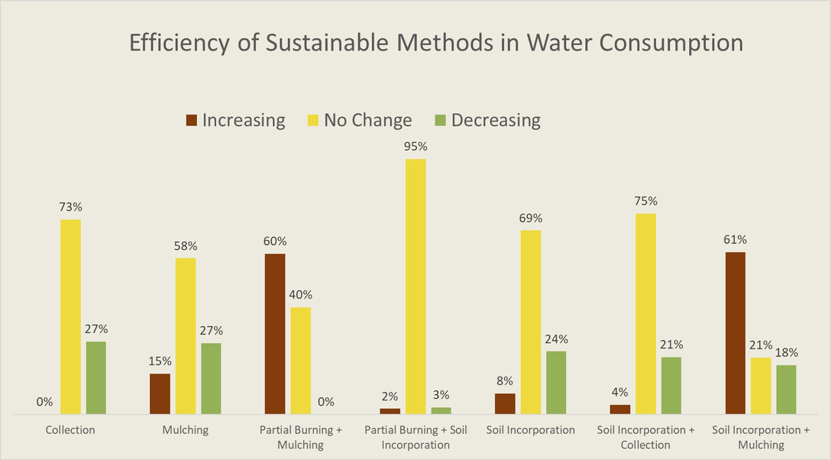
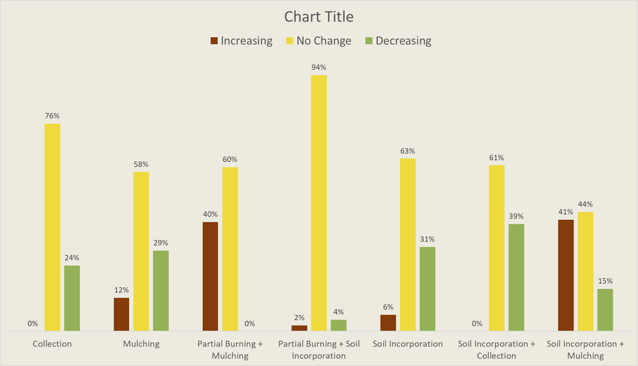
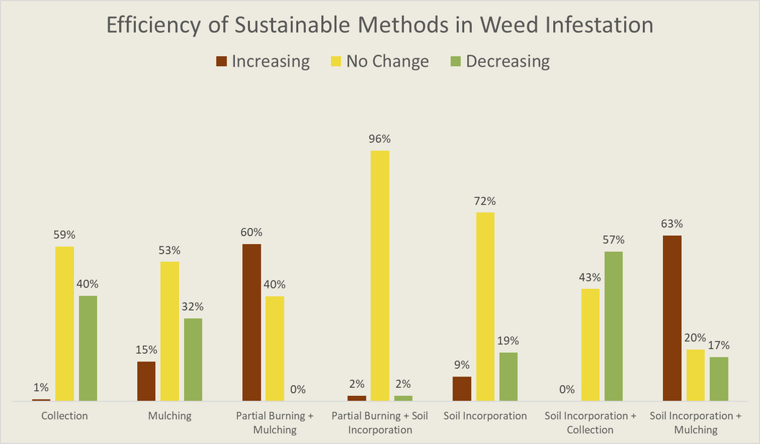

Efficiency of sustainable methods during the year 2020
Water Consumption
Fertiliser Consumption
Weed Infestation

Slide 6



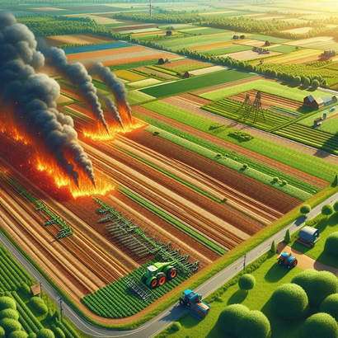


What’s the Future?
Investment required to scale up the adoption to the whole India
INVEST
Tracking the adoption journey, tackling difficulties along with government
HARVEST
Successful elimination Stubble Burning, making India Pollution-Free
CURE
Thank You

